Slide 1
Unbreakable Azure Devops Pipeline using Dynatrace
Safia Habib

Slide 2
Pre Requisites
Download the Source code from here.
Create Azure Devops account from https://aka.ms/SignupAzureDevOps
Create Azure Portal account from https://azure.microsoft.com/free/
A Dynatrace account, get a SaaS free trial here: https://www.dynatrace.com/trial
Create a cheat sheet in a text editor (name : Azure_Devops_values) with the following:
DT_TENANT:
DT_TENANT_TOKEN
DT_API_TOKEN
URL to Monspec File:
URL to PipelineInfo File
PAT:
URL to UnbreakablePipelineGate function:
Token for UnbreakablePipelineGate function:
URL to SelfHealing function:
Notes:
Open a file in your text editor of choice. We will copy URLs and keys as they are generated because we will need those later during the pipelines configuration

Slide 3
THE BIG PICTURE What we are going to do today!

Slide 4
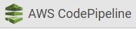
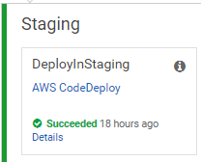
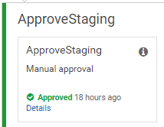
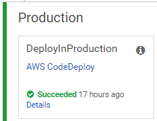
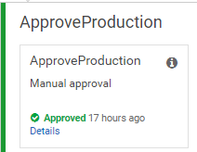





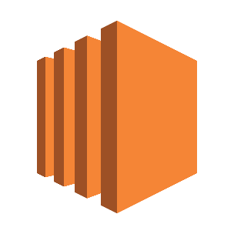




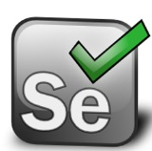

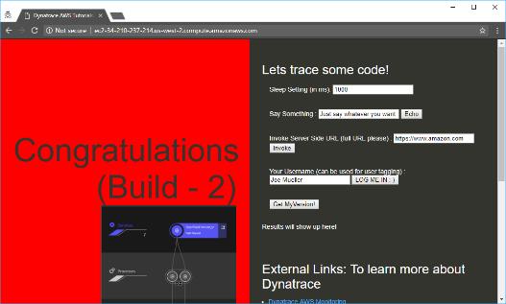
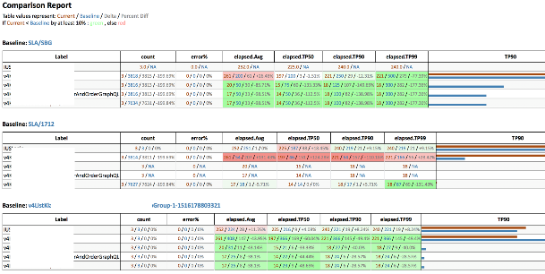
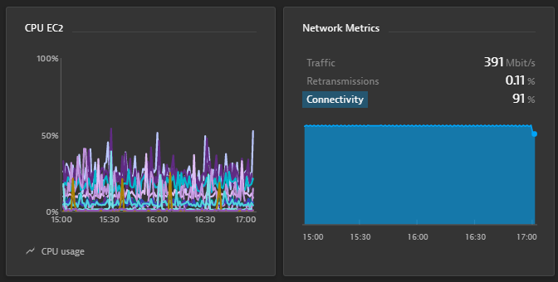
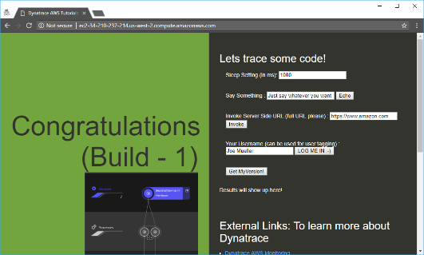
https://github.com/Dynatrace/AWSDevOpsTutorial
AppTeam
Users
AWS CodeDeploy
AWS CodeDeploy
Manual Approval
Manual Approval
Manual Rollback
AWS EC2 (Tag=Staging)
AWS EC2 (Tag=Production)

Slide 5
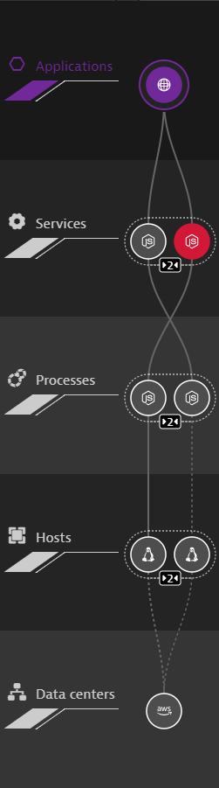
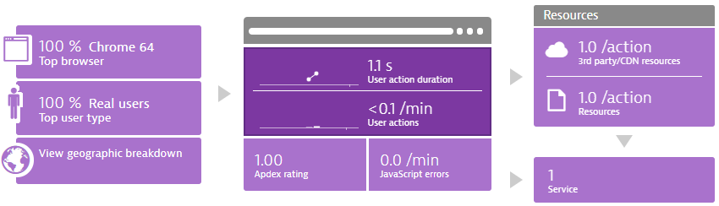
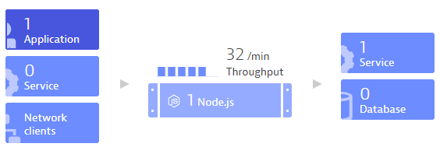
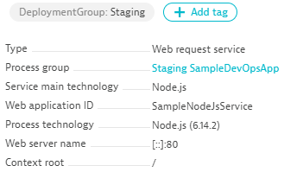
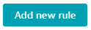



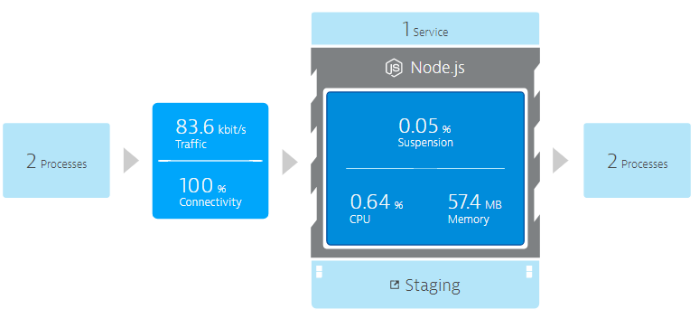
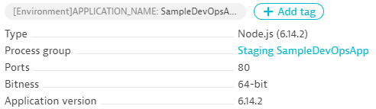
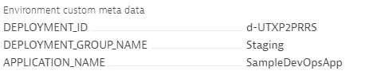

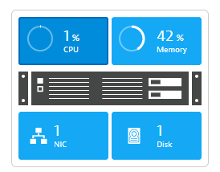


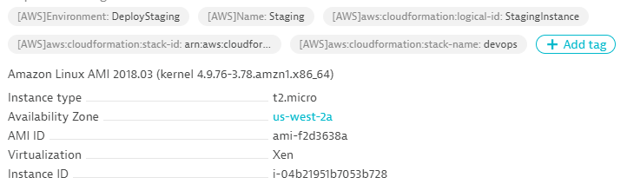


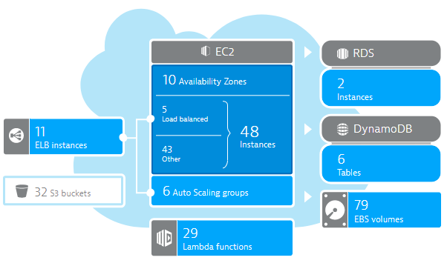
DT_TAGS=APP_NAME=Sample
DT_CUSTOM_PROPS=Staging
DT_CLUSTER_ID=MyNodeJs
launchApp.sh
User Data:
wget OneAgent.sh
./OneAgent.sh
AWS EC2 (Tag=Staging)
CloudWatch

Slide 6
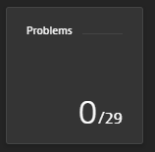
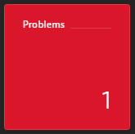

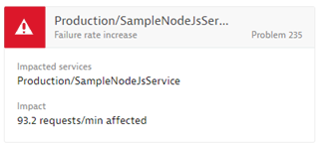
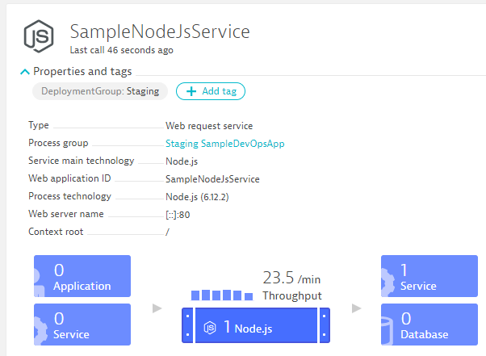
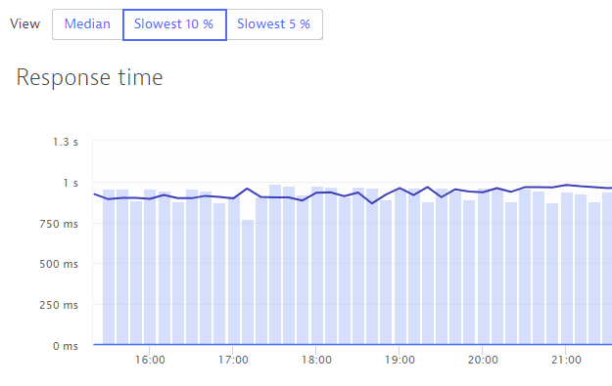
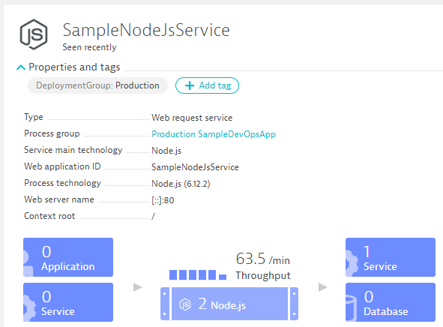
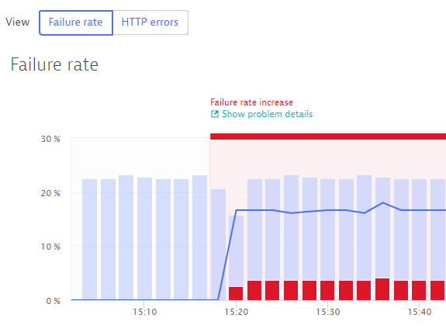

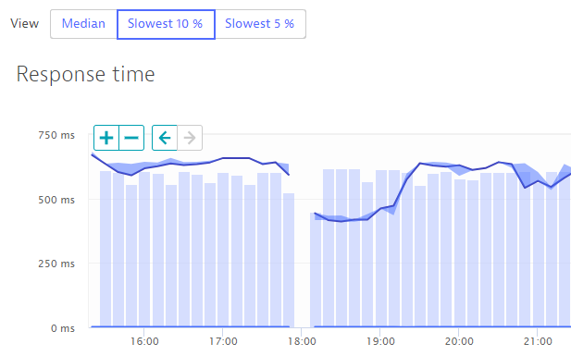
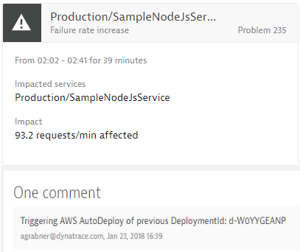
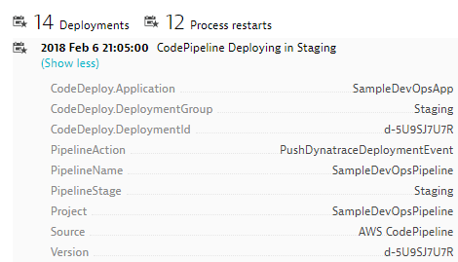
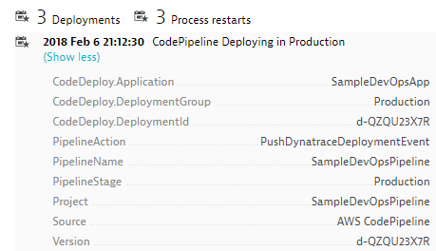
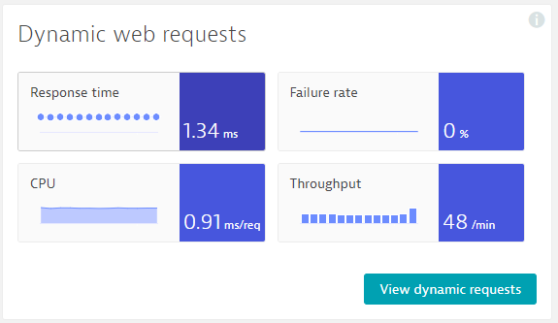
https://github.com/Dynatrace/AWSDevOpsTutorial
Self-Healed
Auto-Approve!
Auto-Approve!
Auto-Reject!
Auto-Reject!
pushDynatraceDeploymentEvent
Pushes Deployment Info to Dynatrace Entities
validateBuildDynatraceWorker
Compares Builds and Approves/Rejects Pipeline
pushDynatraceDeploymentEvent
Pushes Deployment Info to Dynatrace Entities
validateBuildDynatraceWorker
Validates Production and Approves/Rejects Pipeline
Build 6
Production
handleDynatraceProblemNotification
Executes Auto-Remediating Actions, e.g: Rollback
Build 7
Production

Slide 7
For Azure and Azure DevOps
Azure Devops provides multiple development collaboration tools. We will be using:
Azure Repos: Source control repository for the test application
Azure Pipelines: Creating CI/CD pipelines for deploying the test application
Azure Devops Dynatrace Extension: Deployed in Azure Marketplace.
Push Deployment to Dynatrace Task
Release Gate
Azure Functions :
Self Healing Function: This function will redeploy a good build in the event that the bad build has made it to production upon receiving a Performance issue from Dynatrace.
Unbreakable Release gate Function – This is called post deployment from Staging to validate the build
Azure Storage account: Used for storing the monspec file and the pipelineinfo files.
Azure Proxy: Dynatrace Proxy: Utility with Dynatrace cli installed for comparing the Performance information with the monspec file.

Slide 8
More on the Azure DevOps Dynatrace extension
The Dynatrace Extension consists of two components:
Push Deployment Event Task:
The task pushes a Deployment event to Dynatrace when a new version of the application is deployed.
It uses the Dynatrace events API to publish the details of the Deployment.
The event requires URL to the Dynatrace Tenant, API token, Tag Name and Context (Note the Tag needs to be available in Dynatrace for the event to show up).
Unbreakable Release Gate:
The quality gate is executed to test the quality of the current build in Staging against a Monspec file.
In the case that there are no violations the gate succeeds and pushes the code to Production.
In case there are reported Violations then the Release Pipeline fails and the code is not deployed to Production.

Slide 9
Step by Step

Slide 10
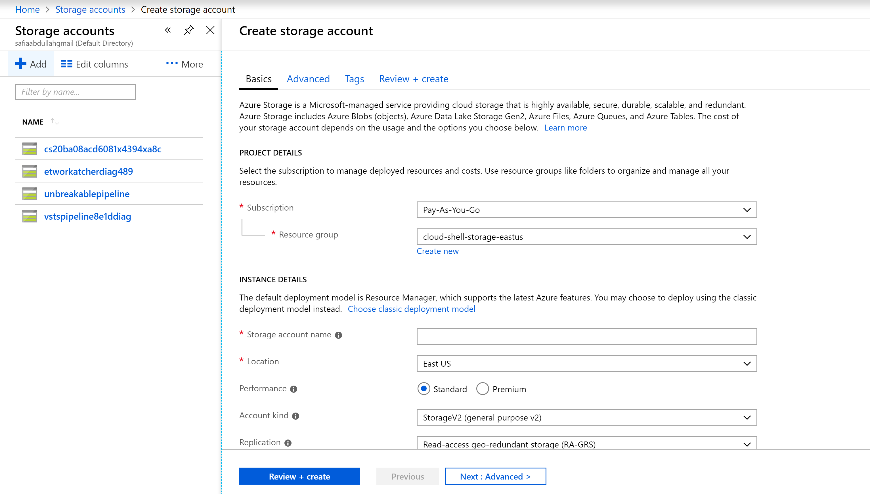
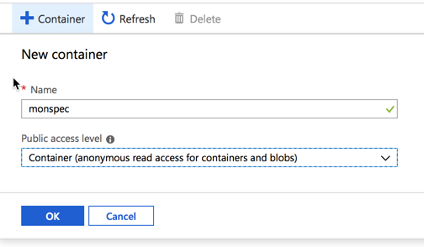
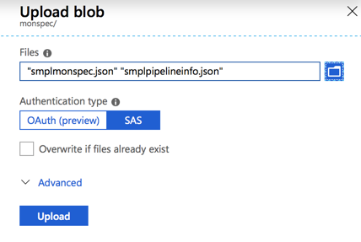
Step 1 : Storage Account
Login to Azure Portal
Create Storage Account
Upload the Monspec folder from the source code to a new Blob container
Notes:
Go in Azure Portal : https://portal.azure.com
Create a Resource Group
Pick up a region, ideally South Central US (tested on)
Create a Storage account (for monspec file)
Enter info, create a new ResourceGroup : IMPORTANT, the name must be unique so append your name to the Resource Group name. For example: unbreakable-pipeline-stevecaron
Select South Central US as a region (tested on)
Click Review + create
Click Create
When your storage account is finished deploying, you will need to create a Blob
Click Go to Resource
Click Blobs in the Storage Account left side menu
Add a new Container, name it monspec and select a Public access level : Container (anonymous read access for containers and blob)
Get into your monspec container and upload the 2 json files from the github repo, from the directory UnbreakablePipelineSource/monspec
For each of these 2 files, we will need the URL later on, so copy the URL to a cheat sheet (open a notepad or text editor)

Slide 11
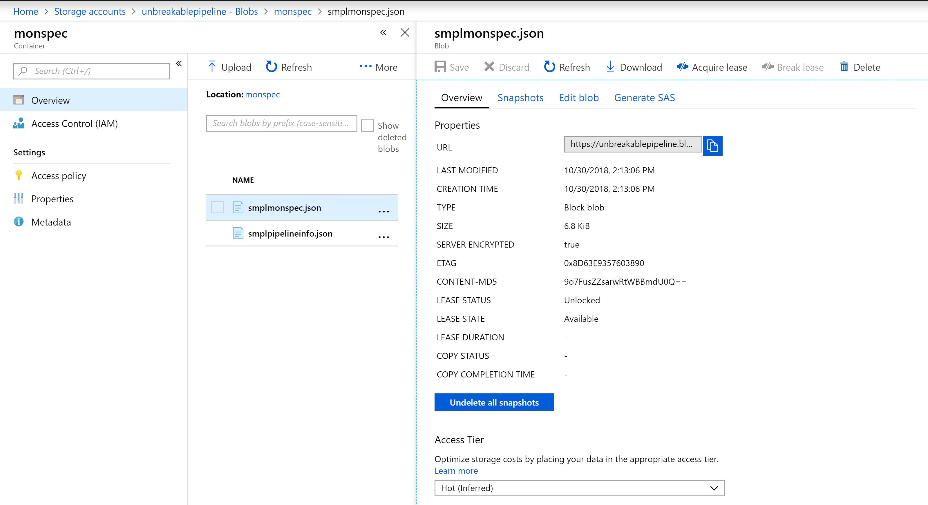
In the Azure_Devops_Values Notepad copy the URL’s of the Monspec file and the Pipeline Info File
Notes:
Copy-paste in your cheat sheet, the URL for each of these 2 files, we will need it later

Slide 12
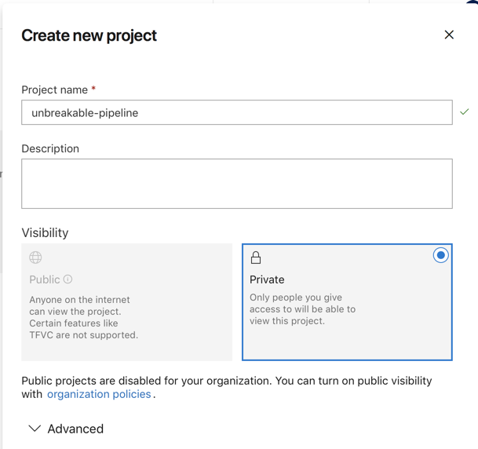
Step 2: Create Azure DevOps Organization and Project
Login to https://dev.azure.com
Create a New Organization
Create a New Project

Slide 13
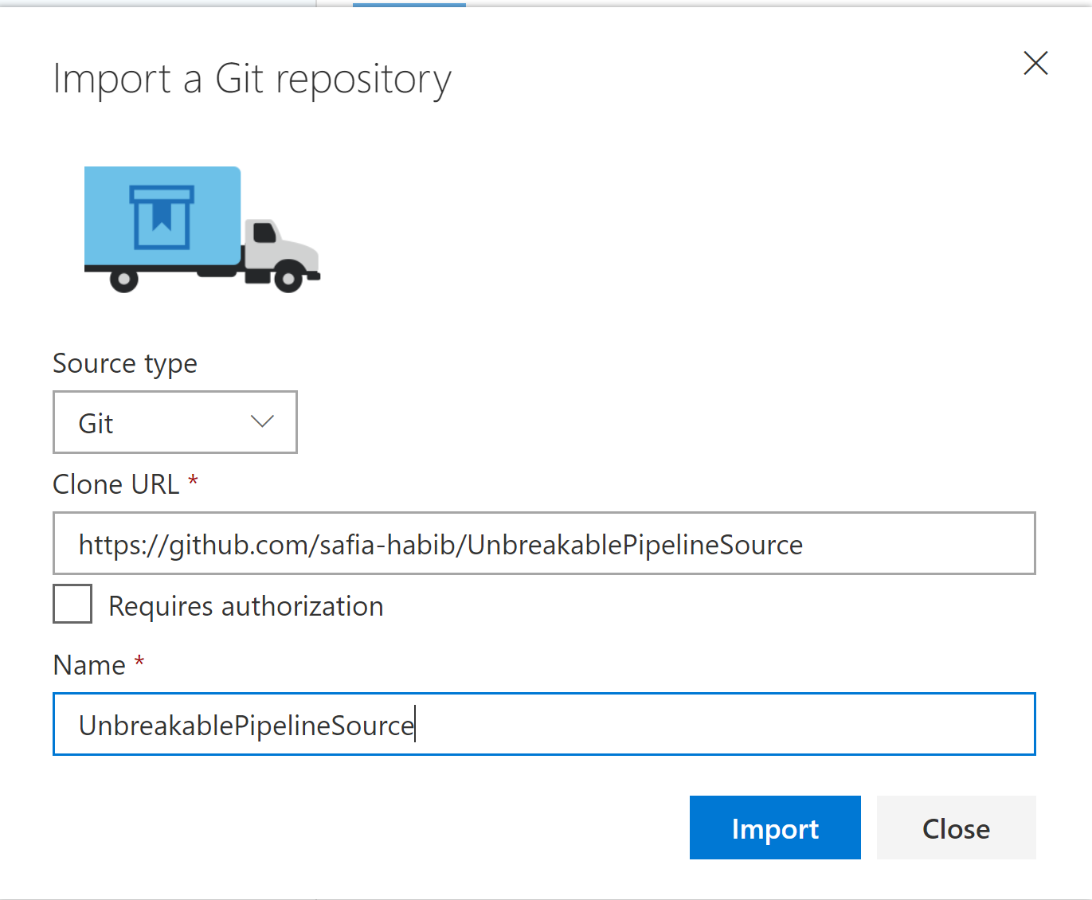
Step 3: Setup Azure Repos
In your project, go to Repos
Import a Git Repository
URL to clone is: https://github.com/safia-habib/UnbreakablePipelineSource

Slide 14
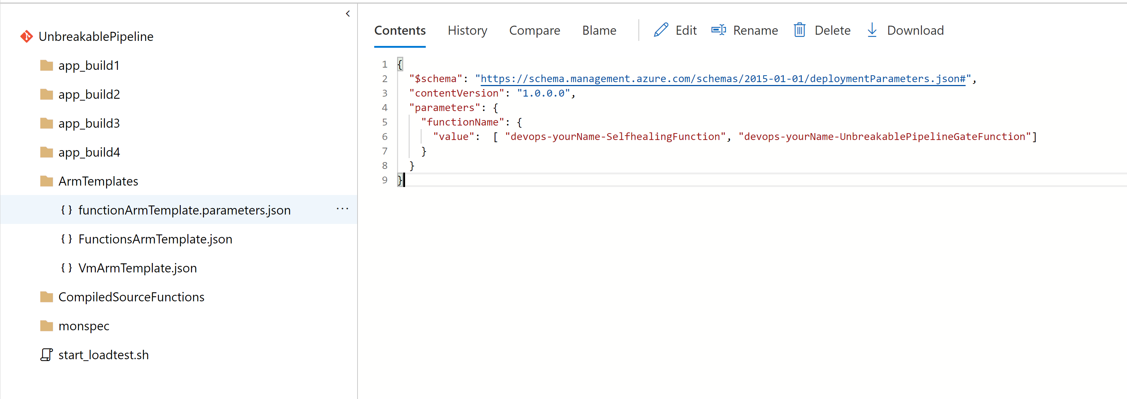
In the imported code navigate to ArmTemplates/functionarmTemplate.parameters.json
Replace <your Name> With your First + Last name, for example : stevecaron
Commit the changes once done

Slide 15
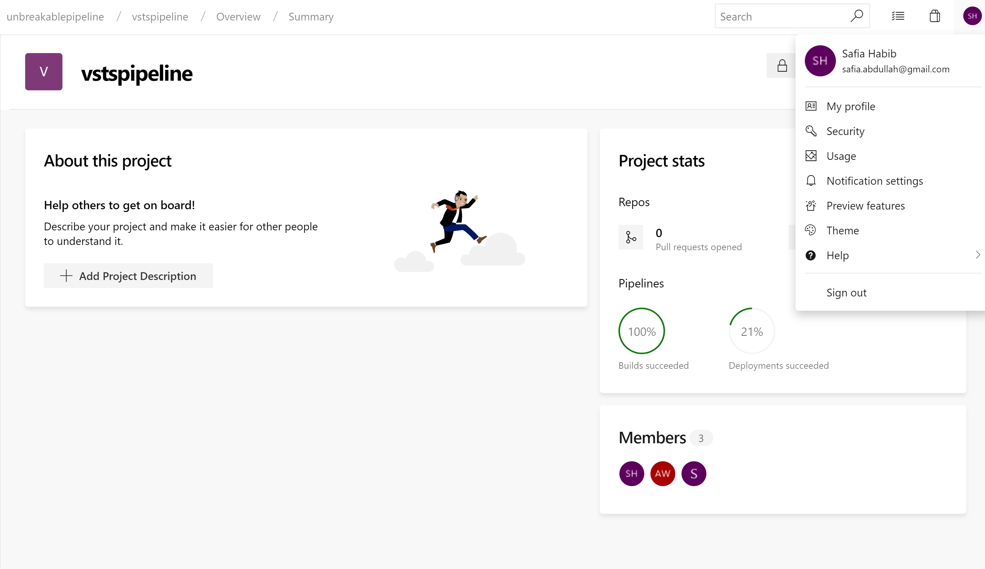
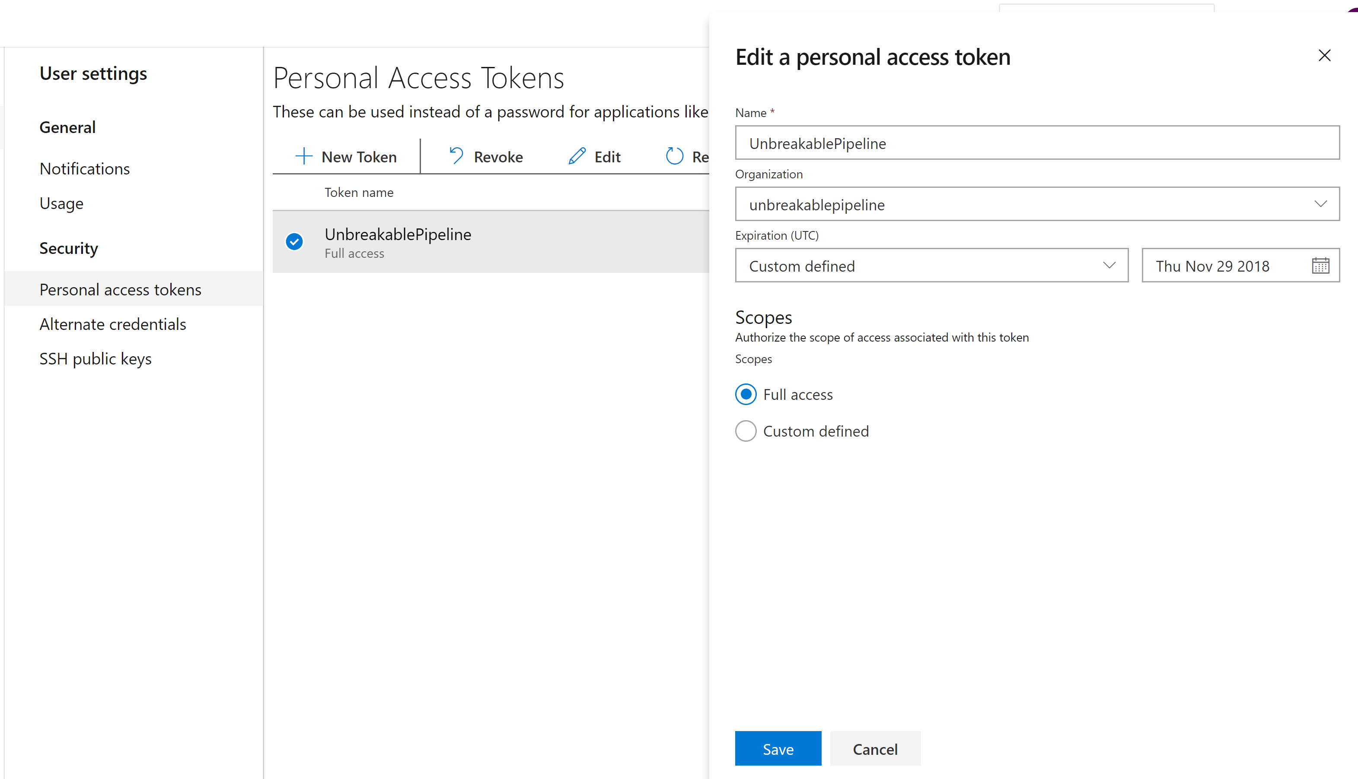
Step 4: Create a Personal Access Token
Create a PAT and Copy Value to the Notepad
Notes:
What is PAT – Personal Access Token : This is used for Authentication between the Azure Devops and Azure Portal.
You will need to define a Personal Access Token
Go in User(topright)->Security->Personal Access Tokens
Create a new token, name it (unbreakable-pipeline-token)
Choose your organization
Select Full access as Scope

Slide 16
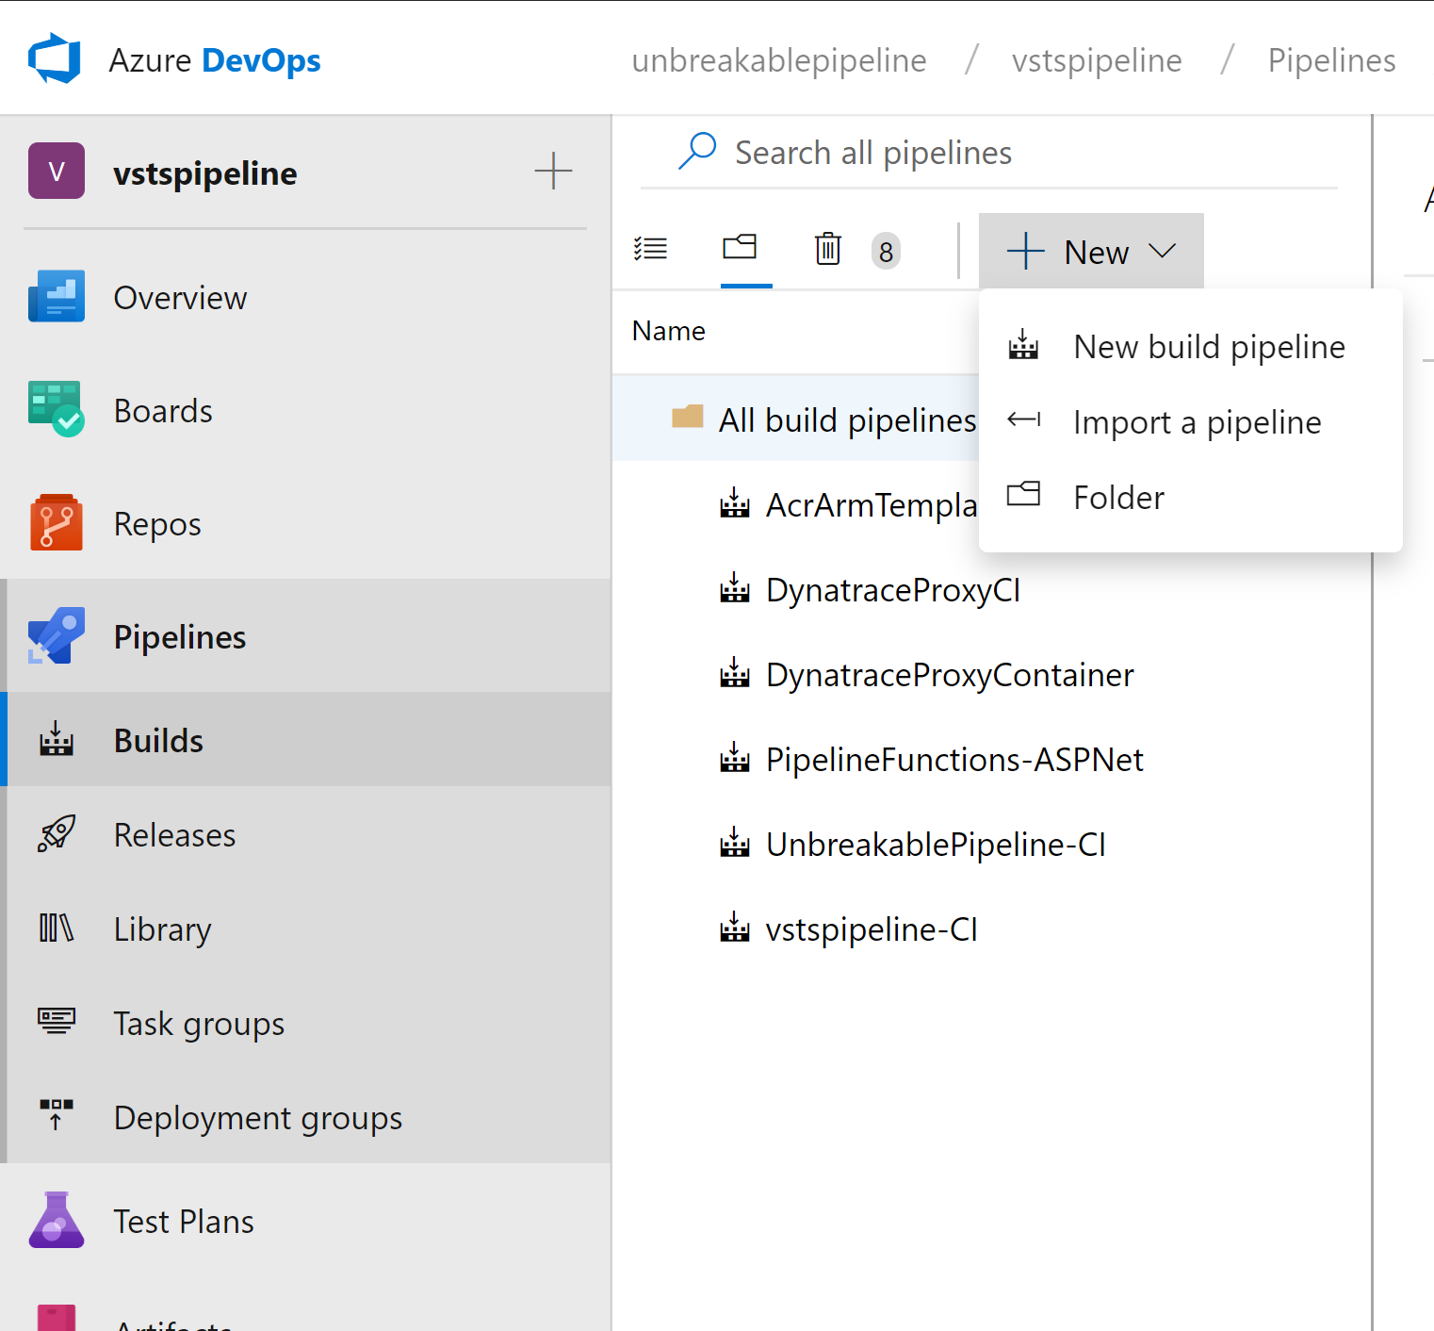
Step 5: Build Pipeline
We have noticed that for new users there is sometimes no option to Import pipeline
In this case create a Dummy Pipeline With any name
To get to the below view and then import the Build pipeline
Go to Pipelines->Build
Create a New Pipeline
Import the Unbreakablepipeline-CI.json
Current Limitation – Name of the Pipeline should match Unbreakablepipeline-CI so you might have to change the name assigned at the import (remove -import)

Slide 17
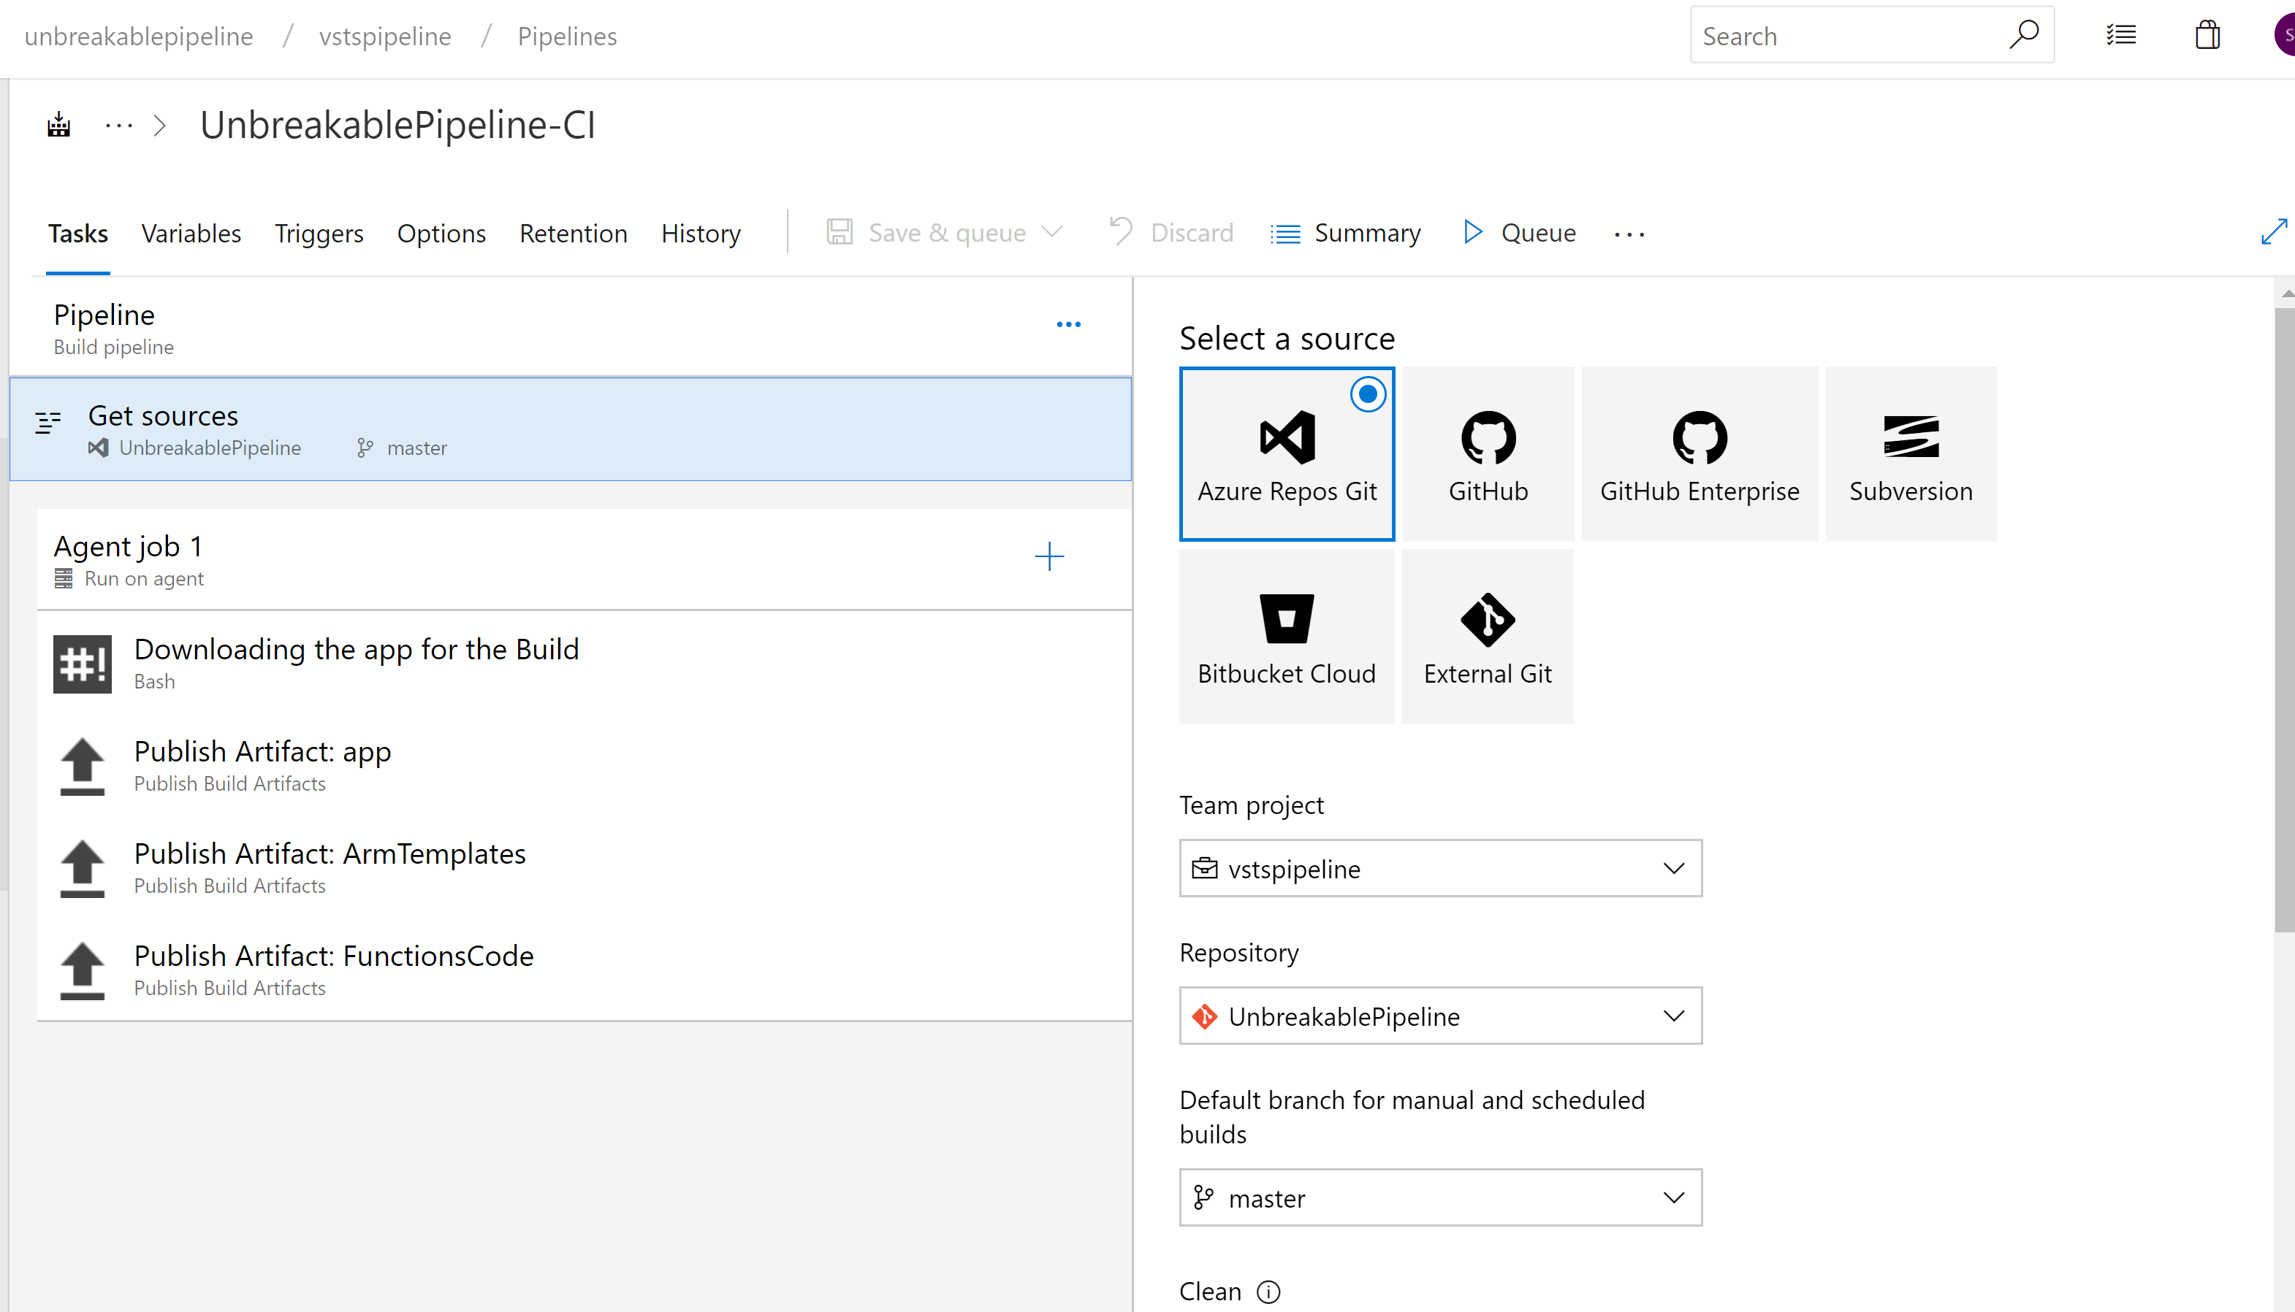
Result
Ensure this matches the Repo Name
You created in Step 2

Slide 18
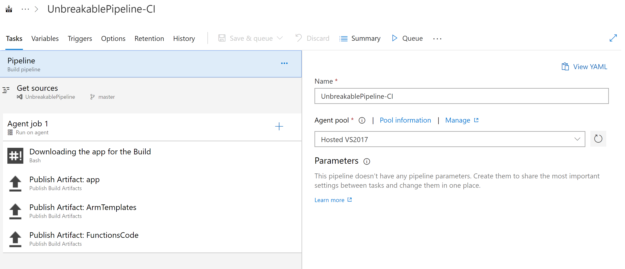
Step 6: Run the Build Pipeline
Queue a Build Pipeline

Slide 19
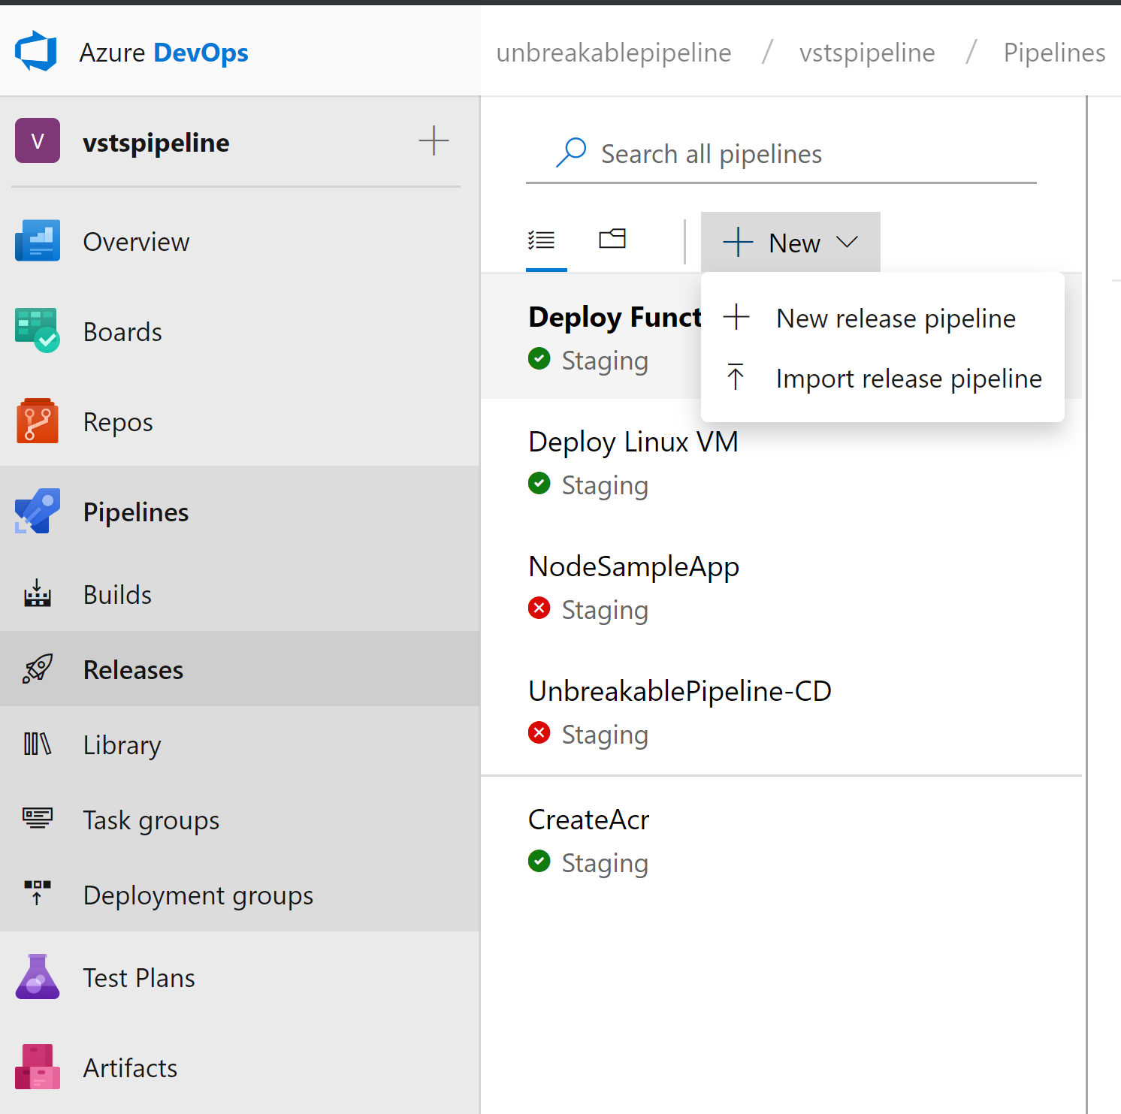
Step 7: Release Pipeline
Go to Pipelines Release
Import the CreateUtilities.json
We have noticed that for new users there is sometimes no option to Import pipeline
In this case create a Dummy Pipeline With any name
To get to the below view and then import the Build pipeline

Slide 20
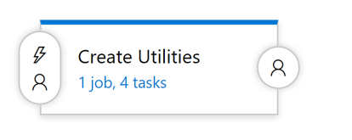
Release Stage
Create utilities
Creates the following in Azure:
Self Healing Function
Unbreakable Pipeline Gate Function
For today we will just deploy the app to the Hosted agent / factory VM available provided by Azure Devops
Staging Linux VM (Excluded for this Workshop)
Production Linux VM (Excluded for this workshop)

Slide 21
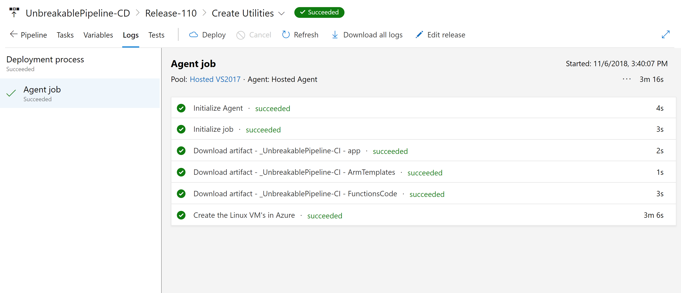
Step 8: Deploy time
First run the Create Utilities Stage

Slide 22
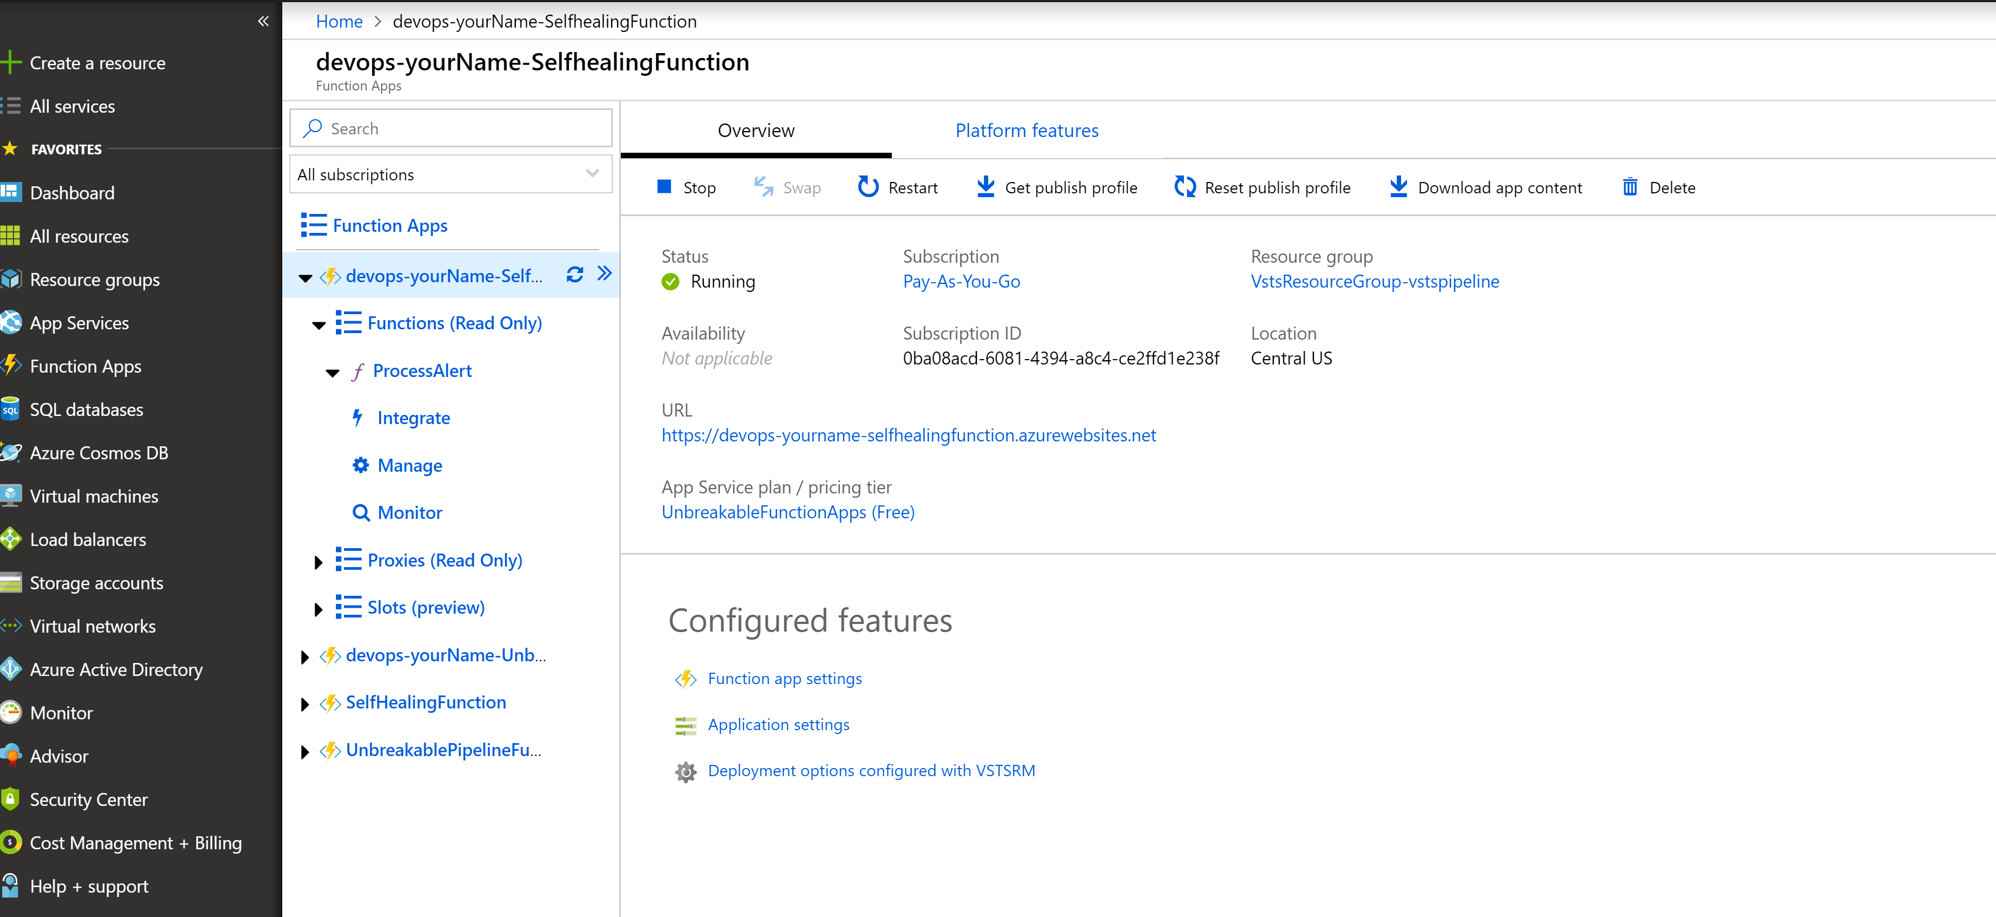
Step 9: Functions URL and Key
Go to Azure Portal and copy the Self Healing Function URL Azure_Devops_values notepad.

Slide 23

Step 9: Functions URL and Key
Get the Unbreakablepipeline function URL and Key – Copy to Notepad

Slide 24

App Pipeline
Import UnbreakablePipeline-CD.json into New Release Pipeline

Slide 25

App Release Pipeline
Staging
Deploys the test app on Staging VM
Starts Loadtest against the test application
Pushes Deployment Event to Dynatrace
Production
Deploys the test app on Staging VM
Starts Loadtest against the test application
Pushes Deployment Event to Dynatrace

Slide 26


Step 10 : Dynatrace Account Info
Menu->Deploy Dynatrace->Install OneAgent->Linux
Copy the wget command
Copy the tenant URL and the installation token on your notepad
DT_TENANT: https://<tenant>.live.Dynatrace.com
DT_TENANT_TOKEN: Value of Tenant token

Slide 27

Step 11 : Dynatrace API Token
Menu->Settings-> Integration-> Dynatrace API
Generate Token
Copy the token value

Slide 28

Step 12: Add Auto Tagging rule to Dynatrace
#2 – Call the Tag “DeploymentGroup”
#3 – For Services
#4– Tag Value comes from our Process Environment Variable
#5 – Only apply rule if env variable exists
#1
Notes:
Tags are added to Process via environmental variables created by the Deploy
- This rule propagates the tag to services to automatically apply Staging vs Production Tags

Slide 29

Step 13: Create Alerting Profile for Production

Slide 30

Step 14: Add SelfHealing Function URL Webhook Integration
To enable auto remediation add the Self Healing Function URL to Dynatrace after creating the alerting profile
WebhookURL: SelfHealingFunction URL + /api/ProcessAlert?name=<YourName>
Don’t forget to select the Production alerting profile (at the bottom)

Slide 31

Step 14 – Release Pipeline Configuration
After Importing the release pipeline go to each stage
For Each Task in each stage you will have to select the Azure Subscription, Resource Group, Location
Add the following values for the Variables in the Variables Section

Slide 32

Push Deployment Event Task
Update the values in Push Deployment Event Task for Staging and Production

Slide 33


Update Release gate

Slide 34
Values for Release Gate
Note: Unbreakable Gate Function URL : URL + api/ProcessUnbreakableGate
Dynatrace Proxy URL: http://40.117.92.217:5000/api/DTCLIProxy/MonspecPullRequest
Service to Compare value: SampleJSonService/StagingToProduction
Authentication Token : PAT Token

Slide 35
Create Release
View Deployment in Dynatrace
Validate Release Gates

Slide 36
Behind the Scenes: Deployment Shift-Right: Version Information, Tags, Meta Data, …

Slide 37

What happens in Release Pipeline Stages?
#1 Executes script shell to start_the app:
export DT_TAGS=APPLICATION_NAME=$APPLICATION_NAME
export DT_CUSTOM_PROP="DEPLOYMENT_ID=$DEPLOYMENT_ID DEPLOYMENT_GROUP_NAME=$DEPLOYMENT_GROUP_NAME APPLICATION_NAME=$APPLICATION_NAME“
export DT_CLUSTER_ID="$DEPLOYMENT_GROUP_NAME $APPLICATION_NAME“
pm2 start app.js &> pm2start.log
#2 DT_CLUSTER_ID
#2 DT_TAGS
#2 DT_CUSTOM_PROP

Slide 38











Shift-Right: Tags, Deployments & Events
Release
Automation
Dynatrace Automation
API, CLI, Auto-Detection
Dynatrace Smartscape
docker run –e DT_TAGS=BLUE
dtcli tag srv CartServicev2 GREEN
dtcli evt push pg tomcat1 desc=JVMMemIncr hint=+100MB
dtcli evt push host .*demo version=123 source={code_deploy}

Slide 39

@ Deployment: Passing Meta Data to launched processes
AWS CodeDeploy executes script during deployment:
export DT_TAGS=APPLICATION_NAME=$APPLICATION_NAME
export DT_CUSTOM_PROP="DEPLOYMENT_ID=$DEPLOYMENT_ID DEPLOYMENT_GROUP_NAME=$DEPLOYMENT_GROUP_NAME APPLICATION_NAME=$APPLICATION_NAME“
export DT_CLUSTER_ID="$DEPLOYMENT_GROUP_NAME $APPLICATION_NAME“
pm2 start app.js &> pm2start.log
#2 DT_CLUSTER_ID
#2 DT_TAGS
#2 DT_CUSTOM_PROP

Slide 40


@ Deployment: Converting Process Meta Data to Tags on Services!
Via Tagging Rule

Slide 41


@ Deployment: Converting Process Meta Data to Tags on Services!
Via Tagging Rule

Slide 42
Automated Tag Rules: Define ONCE in Dynatrace!
#2 – Call the Tag “DeploymentGroup”
#3 – For Services
#4– Tag Value comes from our Process Environment Variable
#5 – Only apply rule if env variable exists
#1

Slide 43




@Deployment: Pass Deployment Information to Deployed Entities
+ CodeDeploy Information from same Stage
Dynatrace Events REST API
pushDynatraceDeploymentEvent
Pushes CodePipeline Info to Dynatrace

Slide 44



Monitoring as Code (Monspec): Define Services and their Environments as Code
Monspec (Monitoring as Code)
"SampleJSonService" : {
"etype": "SERVICE",
"environments" : {
"Staging" : {
"tags" : [
{
"context": "CONTEXTLESS",
"key": "DeploymentGroup",
"value": "Staging"
}
]
},
"Production" : {
"tags" : [
{
"context": "CONTEXTLESS",
"key": "DeploymentGroup",
"value": "Production"
}
]
}
},
pushDynatraceDeploymentEvent
Pulls Tag Information from Monspec
Dynatrace Events REST API
Pushes Event for Entities with Tag DeploymentGroup:Staging

Slide 45
Behind the Scenes: Approval Stage Shift-Left: Automate Metric Comparison to Validate Build

Slide 46


Monitoring as Code: Compare Metrics of Services of Different Environments/Builds
Entity: SampleJSonService
Different Metrics
Environment: Staging
Tag: DeploymentGroup:Staging
Environment: Production
Tag: DeploymentGroup:Production
Metrics: ResponseTime (Avg)
Metrics: ResponseTime(Max) < 10s
Metrics: FailureRate(Avg)
Metrics: ResponseCount
Factor: 90% Less vs Production
Different Comparisons
Compare: StagingToProduction
Source: Staging; Compare: Prod
Factor: Staging = 10% Slower
Compare: StagingToProdYesterday
Source: Staging; Compare: Prod
Factor: 10%, Timeshift: 86400s
Compare: StagingToStagingLastHour
Source: Staging; Compare: Staging
Factor: 0; Timeshift: 3600s
Compare: StageToStageYesterday
Source: Staging; Compare: Staging
Factor: 0; Timeshift: 86400s
Pipeline Run: Validate Build with StagingToProduction
Source (Staging): 1.64ms
Environment: Staging
Environment: Production
Compare (Production): 1.41ms
Threshold (+10%): 1.56ms
Status: VIOLATION

Slide 47




@Approval: Automating Build Validation into your CodePipeline
Monspec from S3
Build Validation Request Item
Pipeline Information
Monspec
Timestamp + Timeframe
Comparison Definition Name
Action Name to Approve / Reject
Staging: Register Build Validation!
Adds Item
registerDynatraceBuildValidation
Adds Build Validation Request
Updates Build Validation Request
Updated Monspec
Updated Status
Approves/Rejects IF “In Progress” & if RegisterBuildValidation was called with that Action Name
triggers
validateBuildDynatraceWork
CloudWatch Events
(e.g: 1min)
Dynatrace Entities & Timeseries REST API
Resolves Tags and gets list of Entities
Queries Metrics for these Entities

Slide 48
Monitoring as Code: The Full Picture
monspec.json
{
"SampleJSonService" : {
"etype": "SERVICE", // "Options are SERVICE, APPLICATION, HOST, PROCESS_GROUP_INSTANCE"
"name": "SampleNodeJsService",
"environments" : {
"Staging" : {
"tags" : [
{
"context": "CONTEXTLESS",
"key": "DeploymentGroup",
"value": "Staging"
}
]
},
"Production" : {
"tags" : [
{
"context": "CONTEXTLESS",
"key": "DeploymentGroup",
"value": "Production"
}
]
}
},
Entity: What Entity do we want to validate?
Environments: Tell us how we can detect these entities in Dynatrace

Slide 49
Monitoring as Code: The Full Picture
Comparision: Which environments do we compare and how!
monspec.json
{
"SampleJSonService" : {
...
"comparisons" : [
{
"name" : "StagingToProduction",
"source" : "Staging",
"compare" : "Production",
"scalefactorperc" : {
"default": 10,
"com.dynatrace.builtin:service.requestspermin" : 90
},
"shiftcomparetimeframe" : 0,
"shiftsourcetimeframe" : 0,
},
{
"name" : "StagingToProductionYesterday",
"source" : "Staging",
"compare" : "Production",
"scalefactorperc" : {
"default": 10,
"com.dynatrace.builtin:service.requestspermin" : 90
},
"shiftsourcetimeframe" : 0,
"shiftcomparetimeframe" : 86400
}
monspec.json
{
"SampleJSonService" : {
...
"comparisons" : [
{
"name" : "StagingToStagingLastHour",
"source" : "Staging",
"compare" : "Staging",
"scalefactorperc" : { "default": 0},
"shiftsourcetimeframe" : 0,
"shiftcomparetimeframe" : 3600
},
{
"name" : "ProductionToProductionLastH",
"source" : "Production",
"compare" : "Production",
"scalefactorperc" : { "default": 0},
"shiftsourcetimeframe" : 0,
"shiftcomparetimeframe" : 3600
}
],

Slide 50
Monitoring as Code: The Full Picture
monspec.json
{
"SampleJSonService" : {
...
"perfsignature" : [
{
"timeseries" : "com.dynatrace.builtin:service.responsetime",
"aggregate" : "avg", // min, max, avg, sum, median, count, percentile
"validate" : "upper", // upper or lower
// "upperlimit" : 100, // Optional: Can be used to define a FIXED THRESHOLD
// "lowerlimit" : 50, // Optional: Can be used to define a FIXED THRESHOLD
},
{
"timeseries" : "com.dynatrace.builtin:service.responsetime",
"aggregate" : “p90"
},
{
"timeseries" : "com.dynatrace.builtin:service.failurerate",
"aggregate" : "avg"
},
{
"timeseries" : "com.dynatrace.builtin:service.requestspermin",
"aggregate" : "count",
“validate" : "lower"
}
],
Metrics: Which Metrics, Aggregation, Upper/Lower Boundaries

Slide 51
Behind the Scenes: Self-Healing Smart Remediation Action based on AI-Detected Problems

Slide 52














Path to NoOps: Better and Smarter Auto-Remediation, Self-Healing, …
?Escalate at 2AM?
…
Auto Mitigate!
…
?
1
CPU Exhausted? Add a new service instance!
2
High Garbage Collection? Adjust/Revert Memory Settings!
4
3
Issue with BLUE only? Switch back to GREEN!
4
Hung threads? Restart Service!
Update Dev Tickets
3
?
Impact Mitigated?
2
Mark Bad Commits
5
Still ongoing? Initiate Rollback!
1
Escalate
5
?
Still ongoing?

Slide 53


Automated Rollbacks with AWS Lambda and AWS CodeDeploy
#1: Push Deployment Information, e.g: CodeDeploy DeploymentId
#3
Uses Dynatrace Events API
to pull CUSTOM_DEPLOYMENT events
#2: Calling Lambda via API Gateway
#4: Redeploy previous revision
handleDynatraceProblemNotification
#5: Push comment to Dynatrace

Slide 54
Simulating Different “Bad” Builds
Application looks at startup for an environment variable BUILD_NUMBER. Allowed values, 1, 2, 3, 4
Build Number | Behavior
1 | No Problem
2 | 50% of requests return HTTP 500
3 | No Problem
4 | Staging OK. 10% Requests fail in Production
To Deploy a different build:
Change the build number value in the associated Build Pipeline variable
Save and Queue
Deploy a new build (Release Pipeline)

